Slide 1
Final project automation 1
Course Instructor: Dr. Ahmad Taher Azar
Email: Ahmad_t_azar@ieee.org
Website: https://www.sites.google.com/site/drahmadtaherazar
17-Dec-17
Design & Implementation of Robotic Infusion Stand.

Slide 2
Team Members
Hedaya Ali (ID 171103)
Mohd Saiful Akmal Bin Razali (ID 171021)
Gabriel de Brito Silva (ID 171020)
Berit Adina Haendel (ID 171018)

Slide 3
Abstract
Infusion Stand is one of the medical supportive tools in the field of biomedical that assist in holding and carrying medications to patients via intravenous injections. Mobilization of Infusion Stand from a place to another place is necessary not only for the patients itself but also for the nurses. Therefore, this leads to not only uneasiness but also inconvenience for both parties. Moreover, the massive size of the Infusion Stand also bring a feeling of irritation as it causes difficulty during maneuvering the Infusion Stand. Therefore, in order to improve the existing situation and current Infusion Stand in the market, we come out with a proposal to design and implement a Robotic Infusion Stand. This robotic Infusion Stand comprises two motors with 2 wheels & a caster ball wheel, distance sensor, Arduino Mega as a microcontroller, joystick as an input of the robot and L298N H Bridge driver to control the rotation direction. The novelty of this robotic Infusion Stand is that, it will moving with an input given on the joystick by the strip reaction and try to follow the person who is in control of the strip. In order to make the robotic Infusion Stand stable, we implemented & fine tuned a Proportional-Integral-Derivative controller so that it able to follow the person & to avoid any obstacle.

Slide 4
Introduction
Infusion Stand is one of the medical supportive tools that not only used extensively in hospitals, clinics, physical practices but also in the supportive care provided in the home. Normally, a conventional Infusion Stand consists of a stand alone metal structure which includes a rod, a chassis which typically equipped with 3, 4 or 5 legs with and a wheels & a hanger with one or more hooks at the upper part of the Infusion Stand. There are a lot of accessories that will be attached to the Infusion Stand such as bag of fluids like a water, medication & blood, urinary hooks, temporary pacemakers, patient handles & support trays. Meanwhile, robotic Infusion Stand is an improved version of existing Infusion Stand whereby it will moving with an input given due to the new elongation of the joystick, which influence by the strip reaction.

Slide 5
Motivation
Research studies from the hospitals, clinics, physical practices and also in the supportive care provided in the home found that one of the main drawback of Infusion Stand that currently available in the market is their difficulty to maneuver freely. When a patient want to move away from a confined area, he or she need to drag their own Infusion Stand or in worse case, to get an assistance from the nurse or any other person nearby him or her. Consequently, the nurse will use up his or her time accompanying the patient itself and serving the patient by dragging the Infusion Stand which ends up give inconvenience to the patient and also unproductive day to the nurse itself. Besides, patient and also nurse complaint about the massive size of Infusion Stand that may causes issues while maneuvering the Infusion Stand.

Slide 6
Objective
There are several objectives for this particular project which are described as follows:
To design and manufacture a Robotic Infusion Stand that tether to the patient and able to maneuver with a given direction.
To implement a PID controller in order to follow the person & to avoid any obstacle.

Slide 7
Controller Concept
vLsp
Subsystem:
Motor Left
Speed Control
Physical System
Robot moves to new position and the strip reaction influences the new elongation of the joystick.
X
Controller 2
rotation
vLcurr
X
+
+
-1
vRsp
Subsystem:
Motor Right
Speed Control
Y
Controller 1
translation
+
vRcurr
Y
+
Motor Subsystem (example left)
Abbreviations:
vLsp/vRsp = setpoint speed for motor left/right
vLcurr/vRcurr = current motor speed left/right determined by encoder
verrL = error of motor speed left (vLsp-vLcurr)
vLsp
verrL
PWM
Controller
Motor TF
vLcurr
+
-

Slide 8
Schematic Diagram
Distance Sensor_
Back
Joystick
x-axis & y-axis value
IR
Distance Sensor_ Left
Arduino Mega
IR
Distance Sensor_ Right
IR
PWM
Wheel_ Left
Motor_ Left
PWM
L298N H Bridge
PWM
Motor_ Right
Wheel_ Right
Battery

Slide 9
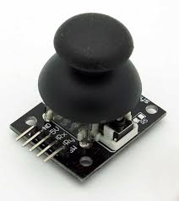
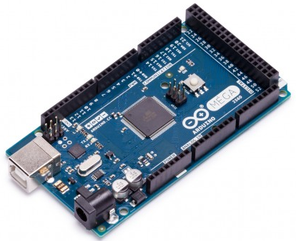
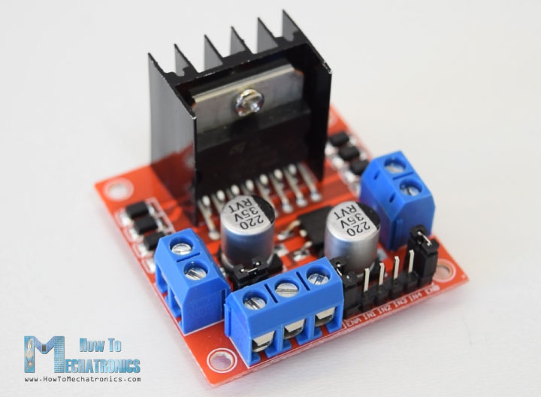
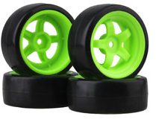
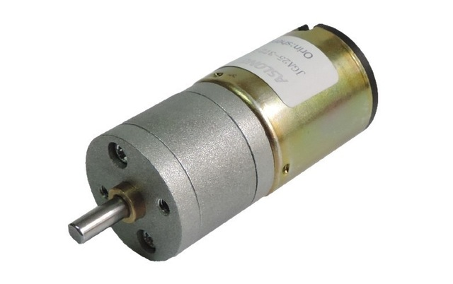
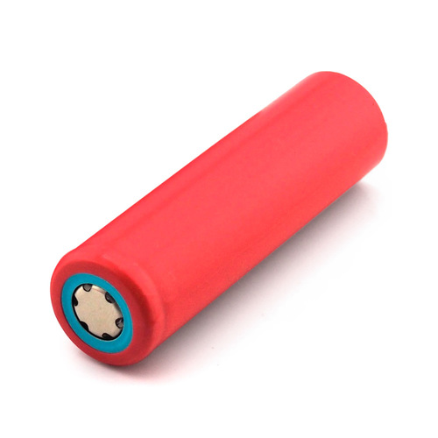
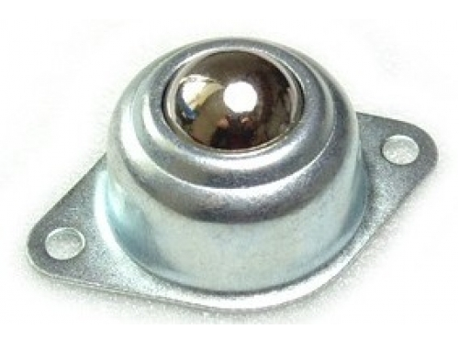
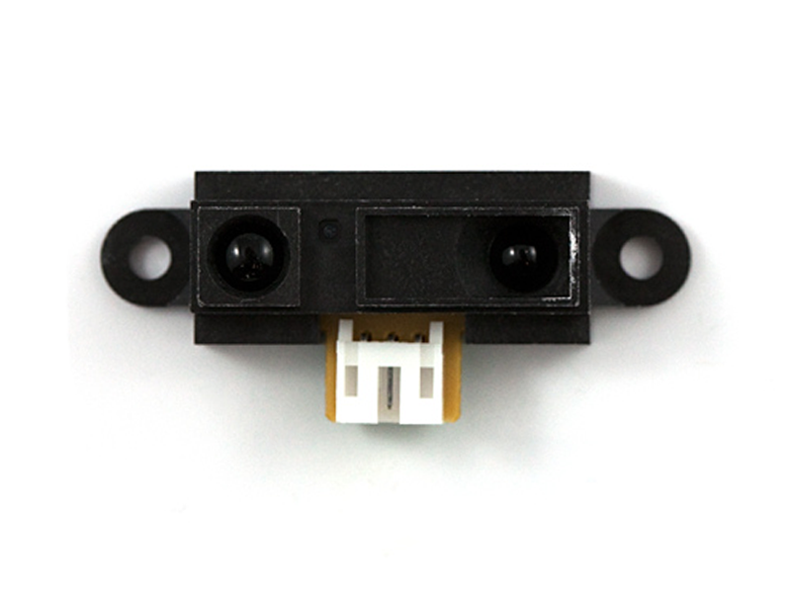
M&E Components
(a)
(b)
(c)
(d)
(e)
(f)
(g)
(h)
Figure x: Mechanical & electronic components. (a) Joystick. (b) Arduino Mega. (c) L 298N H Bridge. (d) 65mm wheels. (e) DC Motor. (f) 3.5V Li-Ion Battery. (g) Caster Ball Wheel. (h) Distance Sensor.

Slide 10
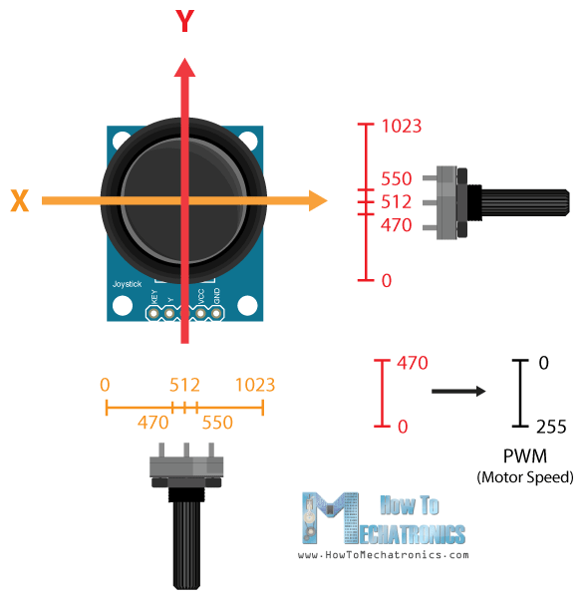
Concept of Joystick
Joystick is theoretically made up of two potentiometers which are connected to the analog inputs of the microcontroller (Arduino Mega). This joystick will have values from 0 to 1023.
Value of the joystick on both axes (x-axis & y-axis) is 512 when the joystick stays in the centre position.

Slide 11
Hardware Design (i)
The overall design of this Robotic Infusion Stand consists of 2 layers of base, wheels, a stand with a joystick. This Robotic Infusion Stand is designed in a triangle shape in order to ease the placement of distance sensors. Three distance sensors will be located at 3 different sides in order to provide an accurate motion sensing. In order to maximize the availability of the space, we installed the Arduino Mega, L298N H bridge, breadboard on upper side of the first base. Below side of the first base is attached with a L-shape motor hubs, motors, 65mm wheels & caster ball wheel. On the second base, we installed fours 3.5V Li-Ion batteries to make sure that the centre of mass is located above the pivot point. Then, a stand is placed on the first base connected through the second base with a hole in the middle of the base itself. Joystick is placed on the highest point of the Robotic Infusion Stand itself which is on the stand with a strip attached to the joystick.

Slide 12
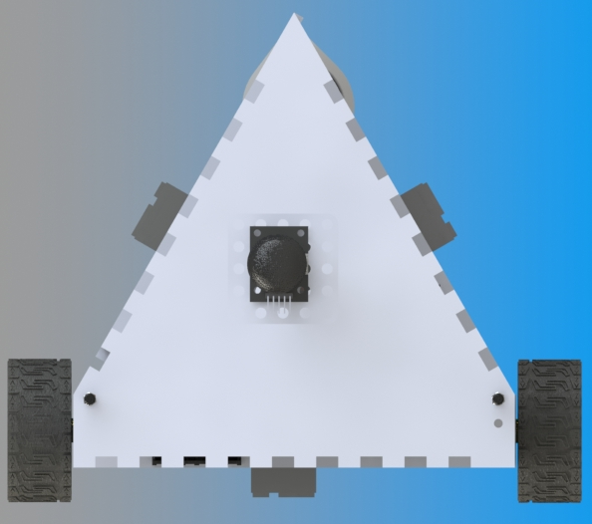
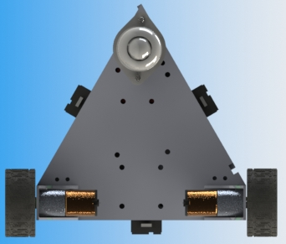
Hardware Design (ii)
(a)
(b)
Figure x: Hardware Design (ii). (a) Top View. (b) Top-Back View.

Slide 13
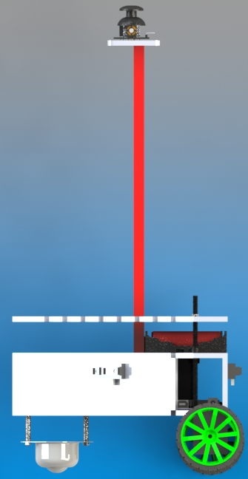
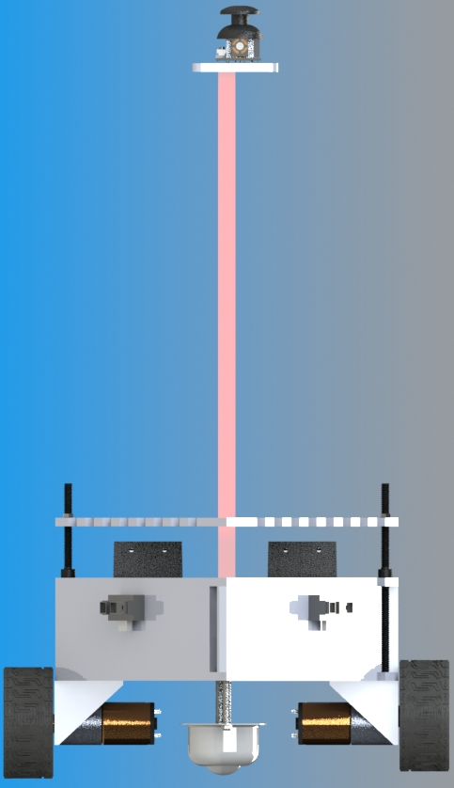
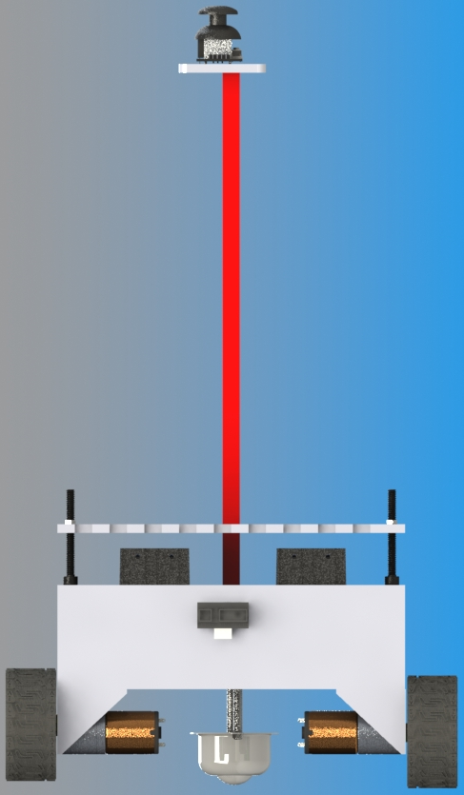
Hardware Design (iii)
(a)
(b)
(c)
Figure x: Hardware Design (iii). (a) Front View. (b) Side View. (c) Back View

Slide 14
Conclusion & Future Work
In conclusion, our Robotic Infusion Stand is working as what we desired. Our Robotic Infusion Stand is able to maneuver with an input given on the joystick by the strip reaction and try to follow the person who is in control of the strip. Our Robotic Infusion Stand also able to avoid the obstacles.
Besides, below are some recommendations that we can do for the future work:
Improving current joystick module with more quantity of potentiometers, so that we are able to get more accurate location.
Transforming the current joystick into an advanced drive though automating the Robotic Infusion Stand.
Implement an alarm system to alert the patients & nurses when the bag of fluids were emptied.
Improving the drive of motors between the transmitting side & receiving side of Robotic Infusion Stand.
Optimize obstacle detection with a wider range.
Implement a non human intervention whereby the Robotic Infusion Stand is not directly tether to the patient.

Slide 15


